Slide 1


Slide 2






Agenda
What it is
Prices
Who we are
Website
Conclusion

Slide 3
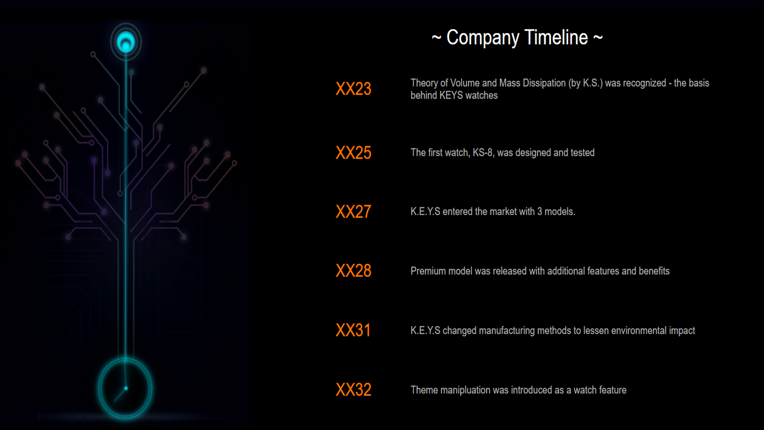

Slide 4

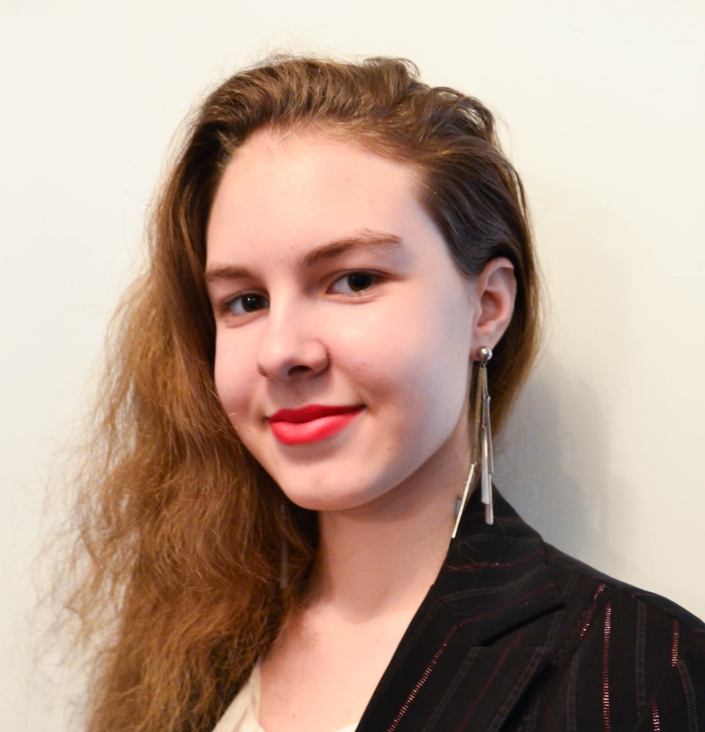
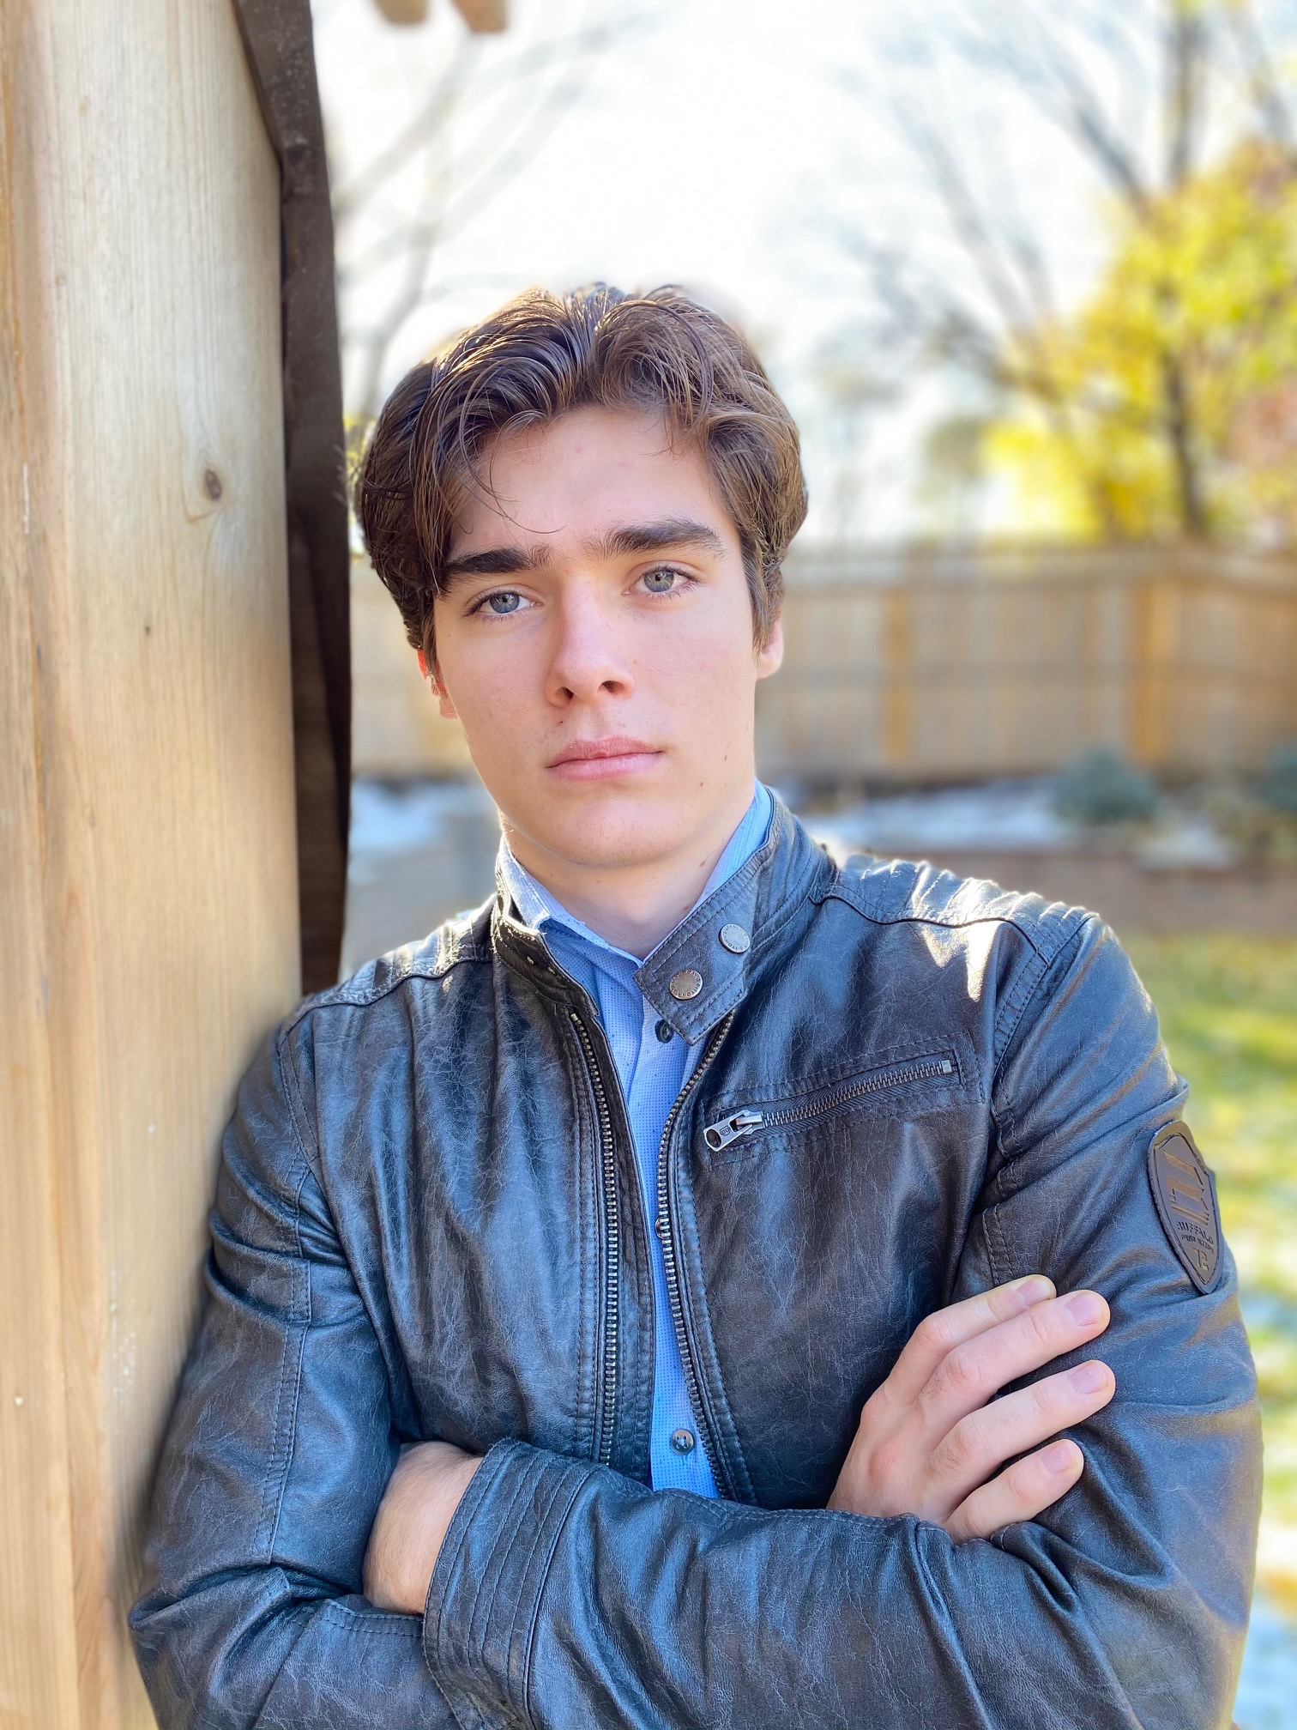

Svetlana Esina
Design specialist
Meet The Team
Daniel Andreev
Role
Jacob Pilon
Role

Slide 5

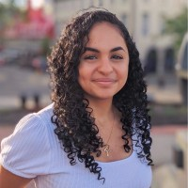
Jayden Bergevin
Design specialist
Meet The Team
Jean-Gabriel de Montigny
Role
Maryan Khalil
Financial Director

